Slide 1
Introduction to Robotics Course no. 8
Andrei Dumitriu
andrei.dumitriu@fmi.unibuc.ro
Faculty of Mathematics and Computer Science
University of Bucharest

Slide 2
Today’s plan
Getting started
Homework & Questions
Short recap from last lab
LCD - Liquid Crystal Display
Matrix Project
3D Modeling (Fusion 360)
Reading data from a PC / laptop

Slide 3
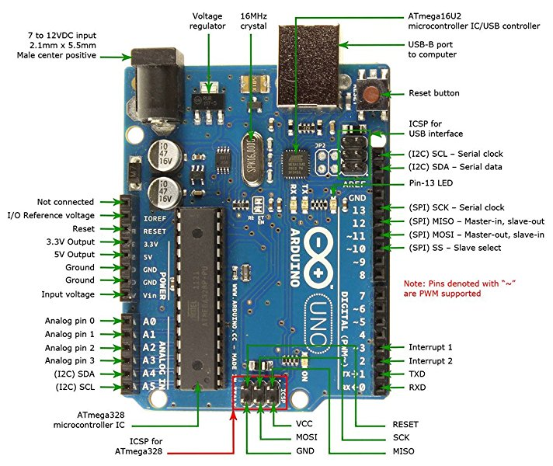
Arduino Uno board

Slide 4
About the course: details
Grading:
1p laboratory, course and/or relevant extra-curricular activity
4p weekly homeworks
2.5p project 1: matrix game (bomberman, tetris etc)
2.5p project 2: line follower
1p: bonus (activities and/or anything extra on the ones above)
Total: 11p

Slide 5
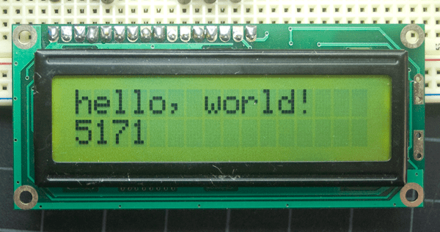
Liquid Crystal Display
Liquid Crystal Display(LCDs) provide a cost effective way to put a text output unit for a microcontroller. As we have seen in the previous tutorial, LEDs or 7 Segments do not have the flexibility to display informative messages. This display has 2 lines and can display 16 characters on each line. Nonetheless, when it is interfaced with the microcontroller, we can scroll the messages with software to display information which is more than 16 characters in length.
This is a character lcd.

Slide 6
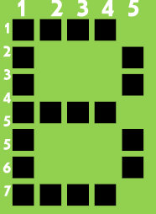
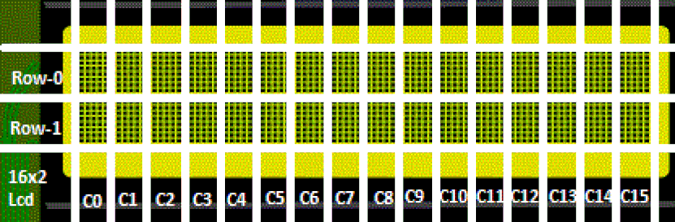
Liquid Crystal Display
The Display Controller takes commands and data from an external microcontroller and drives the LCD panel (LCDP). It takes an ASCII value as input and generates a pattern for the dot matrix. E.g., to display letter 'B', it takes its value 0X42(hex) or 66(dec) decodes it into a dot matrix of 5x7 as shown below. https://www.asciitable.com/

Slide 7
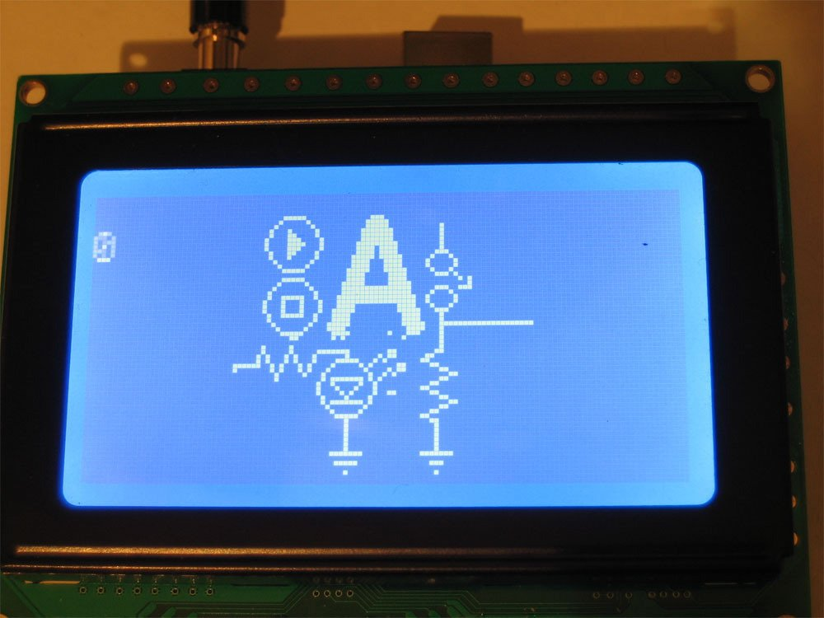
Graphical LCDs
The graphical LCD has one big grid of pixels (in this case 128x64 of them) - It can display text but its best at displaying images. Graphical LCDs tend to be larger, more expensive, difficult to use and need many more pins because of the complexity added.
We will be using character LCDs.

Slide 8
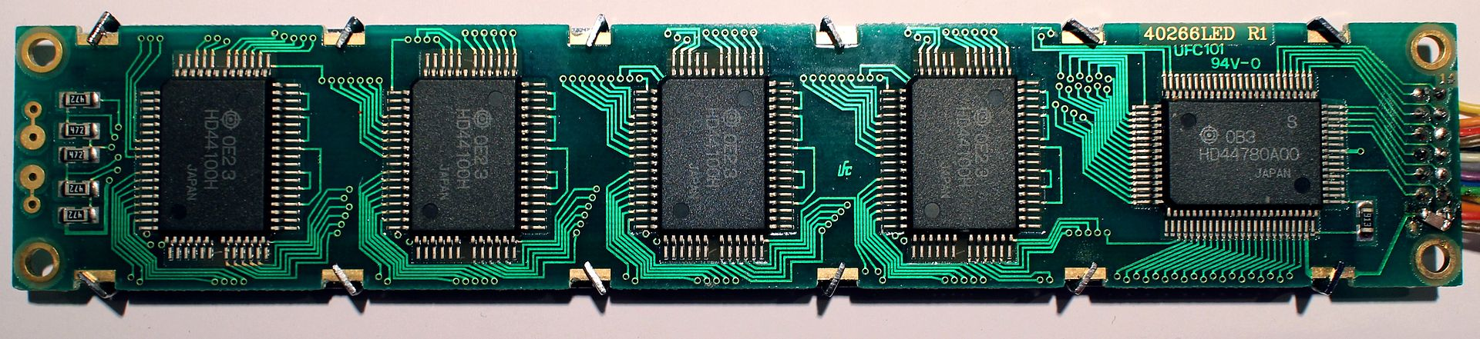
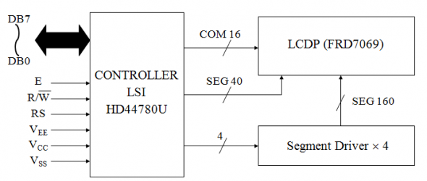
What’s driving it?
The LCD is a simple device to use but the internal details are complex. Most of the 16x2 LCDs use a Hitachi HD44780 or a compatible controller. Yes, a microcontroller is present inside a Liquid crystal display.
The Hitachi HD44780 LCD controller is an alphanumeric dot matrix liquid crystal display (LCD) controller developed by Hitachi in the 1980s. The character set of the controller includes ASCII characters, Japanese Kana characters, and some symbols in two 28 character lines. Using an extension driver, the device can display up to 80 characters.[1] The HD44780 is one of the most popular character LCDs ever made, with numerous third-party displays using its 16-pin interface and instruction set for compatibility. Let’s check the datasheet out: https://www.sparkfun.com/datasheets/LCD/HD44780.pdf

Slide 9
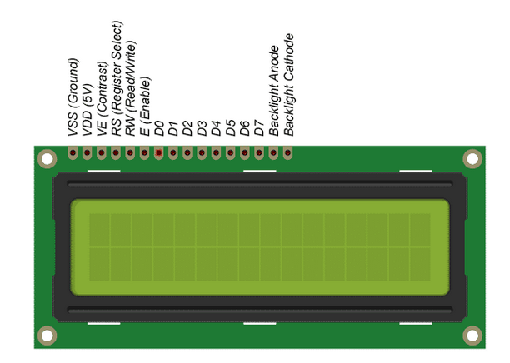
Liquid Crystal Display
VSS (1) | Ground
VDD (2) | 5V
V0 (3) | Contrast adjustment
RS (4) | Register Select. RS=LOW: Command, RS=HIGH: Data
RW (5) | Read/Write (R/W). RW=LOW: Write, RW=HIGH: Read (In most applications reading from the HD44780 makes no sense. In that case this pin can be permanently connected to ground and no io pins need to be allocated to steer it.)
E (6) | Clock (Enable). Falling edge triggered
D0 (7) | Bit 0 (Not used in 4-bit operation)
D1 (8) | Bit 1 (Not used in 4-bit operation)
D2 (9) | Bit 2 (Not used in 4-bit operation)
D3 (10) | Bit 3 (Not used in 4-bit operation)
D4 (11) | Bit 4
D5 (12) | Bit 5
D6 (13) | Bit 6
D7 (14) | Bit 7
A (15) | Backlight Anode(+)
K (16) | BackLight Cathode(-)

Slide 10
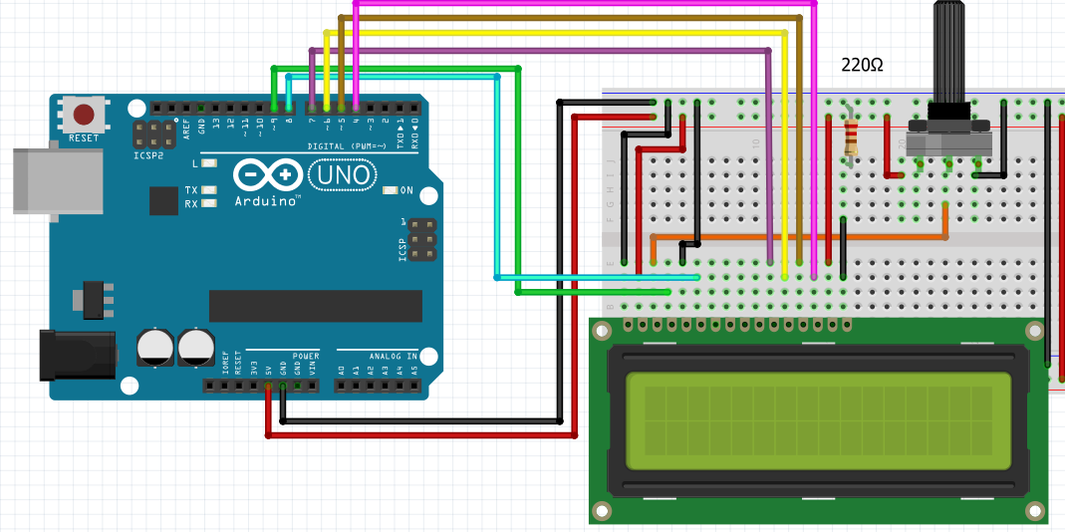
Liquid Crystal Display
LCD can be interfaced with the microcontroller in two modes, 8 bit and 4 bit. Here we interface with the 4 bit. The tradeoff is speed, as we send half as much data in one go, but we gain a reduced number of wires.

Slide 11
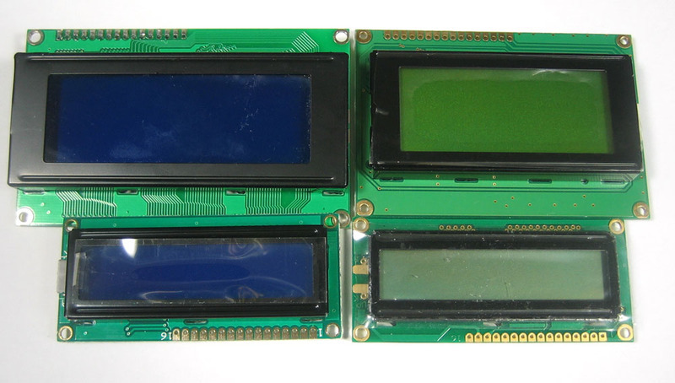
Liquid Crystal Display
Compatible LCD screens are manufactured in several standard configurations. Common sizes are one row of eight characters (8×1), and 16×2, 20×2 and 20×4 formats. Larger custom sizes are made with 32, 40 and 80 characters and with 1, 2, 4 or 8 lines. The most commonly manufactured larger configuration is 40×4 characters, which requires two individually addressable HD44780 controllers with expansion chips as a single HD44780 chip can only address up to 80 characters.

Slide 12
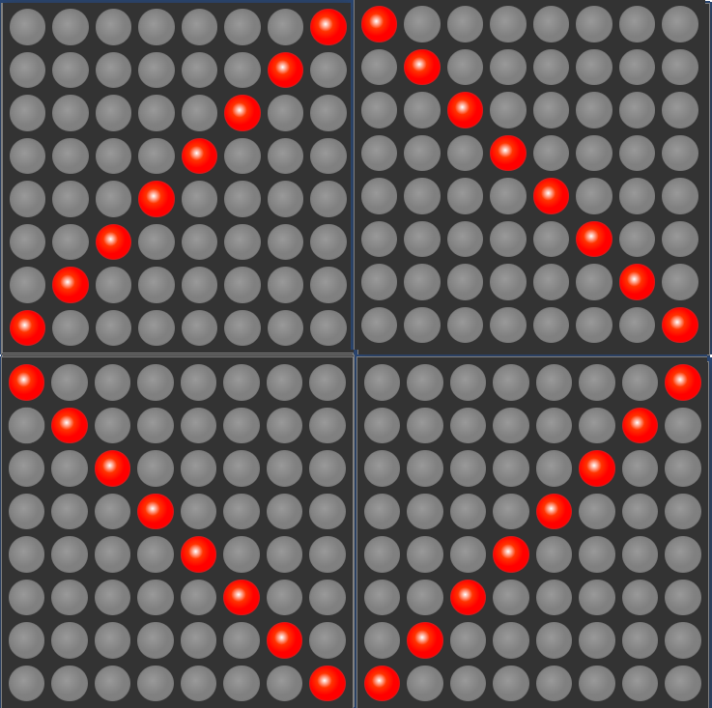
16x16 game on a 8x8 LED Matrix
Fog of War / Field of View
[[0, 0, 0, 0, 0, 0, 0, 1, 1, 0, 0, 0, 0, 0, 0, 0],
[0, 0, 0, 0, 0, 0, 1, 0, 0, 1, 0, 0, 0, 0, 0, 0],
[0, 0, 0, 0, 0, 1, 0, 0, 0, 0, 1, 0, 0, 0, 0, 0],
[0, 0, 0, 0, 1, 0, 0, 0, 0, 0, 0, 1, 0, 0, 0, 0],
[0, 0, 0, 1, 0, 0, 0, 0, 0, 0, 0, 0, 1, 0, 0, 0],
[0, 0, 1, 0, 0, 0, 0, 0, 0, 0, 0, 0, 0, 1, 0, 0],
[0, 1, 0, 0, 0, 0, 0, 0, 0, 0, 0, 0, 0, 0, 1, 0],
[1, 0, 0, 0, 0, 0, 0, 0, 0, 0, 0, 0, 0, 0, 0, 1],
[1, 0, 0, 0, 0, 0, 0, 0, 0, 0, 0, 0, 0, 0, 0, 1],
[0, 1, 0, 0, 0, 0, 0, 0, 0, 0, 0, 0, 0, 0, 1, 0],
[0, 0, 1, 0, 0, 0, 0, 0, 0, 0, 0, 0, 0, 1, 0, 0],
[0, 0, 0, 1, 0, 0, 0, 0, 0, 0, 0, 0, 1, 0, 0, 0],
[0, 0, 0, 0, 1, 0, 0, 0, 0, 0, 0, 1, 0, 0, 0, 0],
[0, 0, 0, 0, 0, 1, 0, 0, 0, 0, 1, 0, 0, 0, 0, 0],
[0, 0, 0, 0, 0, 0, 1, 0, 0, 1, 0, 0, 0, 0, 0, 0],
[0, 0, 0, 0, 0, 0, 0, 1, 1, 0, 0, 0, 0, 0, 0, 0]]

Slide 13
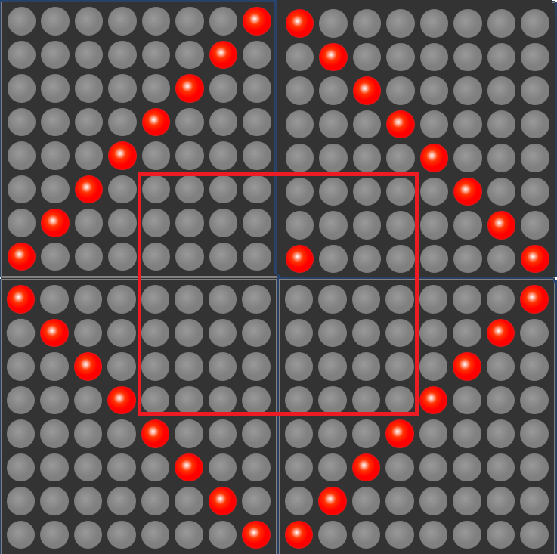
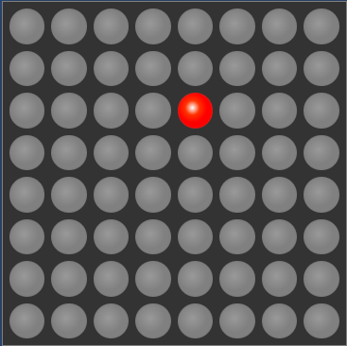
16x16 game on a 8x8 LED Matrix
Fog of War / Field of View

Slide 14
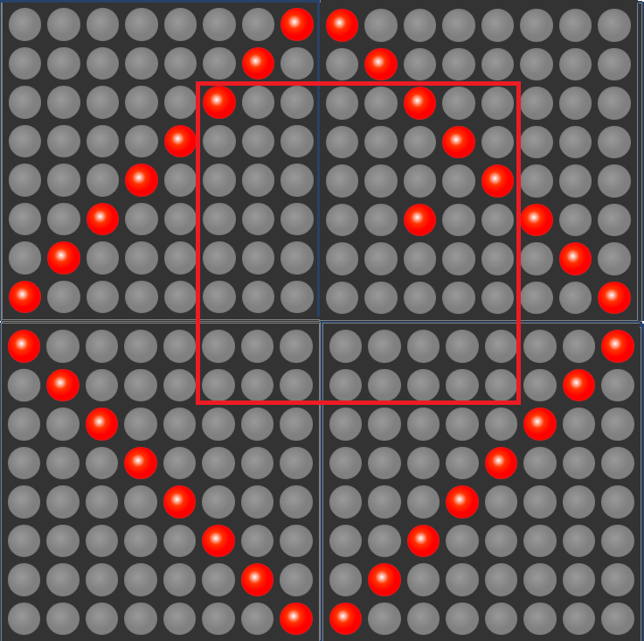
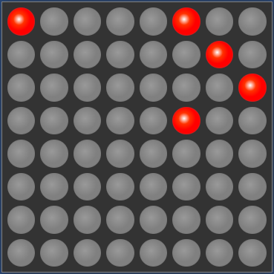
16x16 game on a 8x8 LED Matrix
Fog of War / Field of View

Slide 15
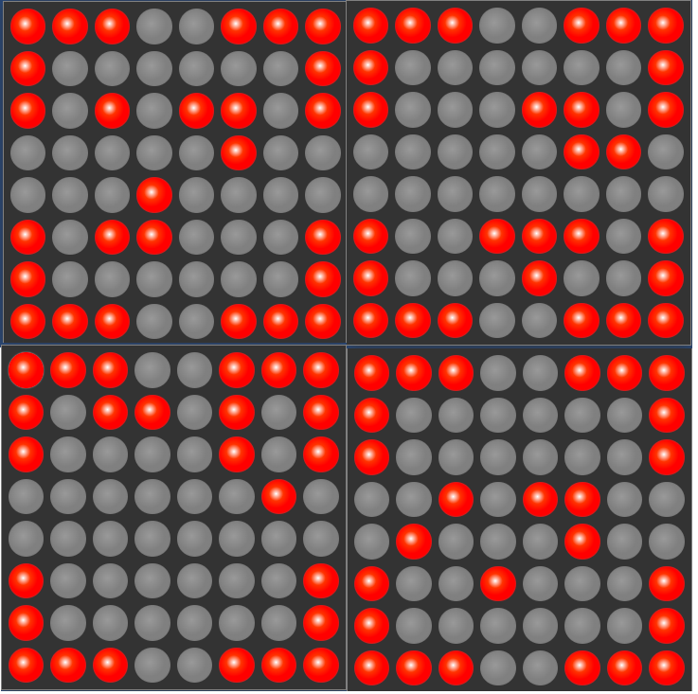
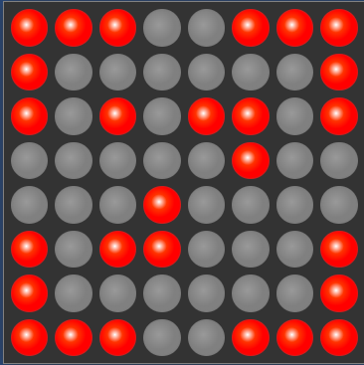
16x16 game on a 8x8 LED Matrix
Multiple Rooms

Slide 16
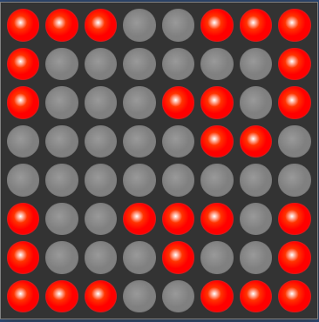
16x16 game on a 8x8 LED Matrix
Multiple Rooms

Slide 17
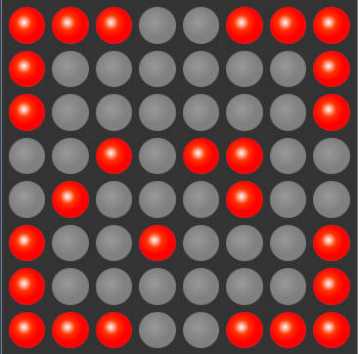
16x16 game on a 8x8 LED Matrix
Multiple Rooms

Slide 18
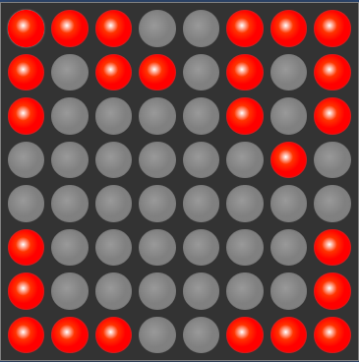
16x16 game on a 8x8 LED Matrix
Multiple Rooms

Slide 19
3D Modeling in Fusion360
2019 - 2020 Course: https://www.youtube.com/watch?v=c1Eo2ClsUNo&list=PLFglUCrrcNc9SgeOwUdVLGXj5Gal2zP74&index=1
2020 - 2021
Course: https://www.youtube.com/watch?v=0Q7ne7NkmzM&list=PLFglUCrrcNc8-yT_D4yHQ1Xn0mK7rZQo1
Laboratory: https://www.youtube.com/watch?v=eAwrP_glbrc&list=PLFglUCrrcNc8UePTEi0YEC8yV1t7EBdCW

Slide 20
Links
HD44780 Datasheet: https://www.sparkfun.com/datasheets/LCD/HD44780.pdf
Led Matrix Editor: https://xantorohara.github.io/led-matrix-editor/
F Macro for strings: https://www.baldengineer.com/arduino-f-macro.html
LCD Char Generator: https://omerk.github.io/lcdchargen/

